Slide 1
Architecture
VMware NSX-T Data Center

Slide 2


NSX-T Datacenter Components
Management, Control and Data Planes
Management/Control Plane
GUI/REST/CMP
Converged management & control plane cluster
3 node cluster for scale & high availability
UI/API for interacting with user, automation & CMP platforms
Validates and Stores desired configuration
Maintain and propagate dynamic state
Cloud Service Manager
Management/Control Plane
NSX Container Plugin
NSX Manager Cluster
vCenter(s)
VMs Containers
Private Cloud
ESXi host
KVM host
Bare Metal
Server
NSX Edge
Distributed data plane
Host workloads (VMs, containers)
and services
Implements distributed routing & firewalling
Data Plane
N-VDS
N-VDS
NSX
Public Cloud
Linux
VM
Windows
VM
NSX
Cloud
GW
VMware Cloud on AWS
NSX
NSX
NAT
Notes:
This is a high level overview of the management, control plane and data plane and how it relates to the DFW.
You configure your policies at the NSX Manager, which performs validation and stores your firewall configuration elements such as rules, sections and grouping objects.
Then the policy is pushed to the control plane cluster. The controller will take the rules that you configured and convert the objects that you used in your rule definition such as logical switches or Nsgroups into IP addresses. The policy using IP addresses is then pushed to the hypervisor
What I wanted to illustrate again here is that with NSX-T, the configuration push is done from the MP plane, through the Central Control Plane to the transport node or hypervisor.
At the bottom here you see 3 hypervirosr, the one on the left and center are ESXi, in which a the Local Control Plane or LCP receives the DFW configuration from the Central Control Plane. This is a local process that runs in userspace and pushes the information down to the hypervisor kernel.
The hypervisor on the right is KVM. You can see that for KVM, there is an additional component, which is the NSX-agent. For KVM, This NSX-Agent is the primary local control plane agent. While the mamangent and control plane implementation on NSX-T for ESXI is different from NSX-V, the kernel space implementation is the same. For KVM, everything is new, so Let’s have a more detailed look at the KVM implementation.
Management Plane
NSX-T management plane is NSX-T Manager. The user interacts with NSX-T manager using Graphical User Interface(GUI) or using REST API framework. When a user configures a firewall policy rule NSX manager validates the configuration and stores persistently on NSX manager. NSX manager pushes user published policies to the control plane cluster (CCP) which in turn pushes to the dataplane. Typical DFW policy configuration would consist of one or more sections with a set of rules using objects like IP sets, NSGroups, Logical switches and more.
For monitoring and troubleshooting of NSX-T manager interacts with Management Plane Agent (MPA) on hosts for getting DFW status, rule & flow statistics for DFW.
Management Plane also does VM Inventory collection, to collect an inventory of all hosted virtualized workloads (VM’s) on NSX-T transport nodes. This is dynamically collected and updated from all NSX-T transport nodes.
Control Plane
NSX-T control plane consists of two components, Central Control Plane (CCP), which includes NSX-T controller clusters, and Local Control Plane (LCP), which consists of userspace module on all of the NSX-T transport nodes which interact with CCP for exchanging configuration and state information.
From user DFW policy configuration perspective, the NSX-T controllers (CCP) will receive policy rules pushed by NSX-T manager. If the policy contains the objects like logical switches or NS groups, it converts the objects used in the rule into IP addresses using Object to IP mapping table, which is maintained by the controller and updated using IP discovery mechanism. Once the policy is converted into a set of rules based on IP addresses, then CCP pushes the rules to the Local Control Plane(LCP) on all NSX-T transport nodes (hypervisor).
CCP controllers have concept of transport node mastership to distribute the load of CCP to LCP communication.The transport node mastership is distributed across the controllers in CCP clusters based on internal hashing mechanism. For example if you have 30 nodes and 3 controllers each controller roughly have mastership of 10 transport nodes.
Dataplane
The NSX-T transport nodes makes distributed data plane with DFW enforcement done at the hypervisor kernel level. Each of the transport node, at any given time, connects to only one of the CCP controller based on mastership for that node.On each of the transport node, once Local control plane (LCP) has the policy configuration from CCP it pushes the firewall policy and rules to the data plane filters (in kernel) for each of the virtual NIC’s. With “Applied To” field in the rule or section which defines scope of enforcement, LCP makes sure only relevant DFW rules are programmed on relevant virtual NICs, instead of every rule everywhere which is not the optimal use of hypervisor resources. Additional details on data plane components for both ESXi and KVM hosts explained in following sections.
•NSX-T Transport Node addition generates unique UUID which is shared by MP with all the controllers.
• CCP cluster decides on mastership for this new transport node based on internal hashing/sharding algorithm on node UUID.
• This results in node mastership assigned to a controller, and going forward this controller is responsible for all CCP-LCP communication to the node
• MP sends all configured CCP cluster member details to the transport node through MPA on node. The details include ip/port and certificate for each CCP node.
•Transport Node connects to one of the CCP controller from the list. If it is not elected master for that node then controller will update with controller info which has mastership for that node. And TN connects to its master.
•At any given time, any node would have CCP connectivity to only one controller
•CCP controller send update on this connection to LCP on transport node
•CCP has mechanism to rebalance & distribute the transport node mastership across controller nodes in case of failure/bring up of controllers or nodes
• In a NSX-T cluster, CCP distribute out the mastership of all transport nodes across available controller nodes, which provides control plane scaling and better performance. If you have 30 nodes and 3 controller each node roughly has mastership of 10 nodes.
•NSX-T uses node mastership model for both DFW & networking. Unlike in NSX-v where nodes used to connect to one or more controllers based on logical switch members on the hosts., i.e. Logical switch mastership model.

Slide 3
NSX-T Manager – A Converged Appliance
Merging policy, management, and central control services on a cluster of nodes
Feature
NSX Management Cluster
Cluster of three NSX management nodes
Management plane, central control plane and policy roles on each node.
Replicated desired state datastore
Manager A
Manager B
Manager C
Policy Management Plane
Central Control Plane
Benefit
Availability of all management services
Improved install and upgrade
Easier operations with less systems to monitor and maintain
Distributed Persistent Database

Slide 4
NSX-T Manager Clustering with Virtual IP
A highly available management plane for GUI and API
IP D is a Cluster Virtual IP attached on one Manager (leader)
Managers must be in the same subnet
GARP used when Manager with Virtual IP Fails
Cluster IP is only used for north bound. South bound to hosts uses Physical IP of the node
Feature
API or GUI Client
Cluster of three NSX managers
API and GUI available on all managers
Replicated desired state datastore
IP D – Virtual IP
Benefit
IP A
IP B
IP C
High availability of the NSX GUI and API
Reduces the likelihood of failures of operation of NSX
Provides API and GUI clients with multiple endpoints or single VIP for availability
NSX Management Cluster

Slide 5
NSX-T Manager Clustering with Load Balancer
A highly available management plane for GUI and API
API or GUI Client
Feature
Cluster of three NSX managers
API and GUI available on all managers
Replicated desired state datastore
VIP
All Nodes Active
VIP Load Balances to Multiple Managers
Managers can be in different subnets
External Load Balancer
(NSX or Third-Party)
Benefit
IP A
IP B
IP C
High availability of the NSX GUI and API
Reduces the likelihood of failures of operation of NSX
Provides API and GUI clients with multiple endpoints or single VIP for availability
NSX Management Cluster

Slide 6
NSX-T Manager Appliance
Feature
Manager
&
Policy
Controller
Manager Appliance
Manager&Policy
Multiple roles merged into a single appliance
Unified Node API
Support Bundle
Controller
The manager appliance can be clustered for high-availability & scale-out
Less management overhead with reduced the number of MP/CCP appliances
Less resources(memory, CPU and disk) required
One-time sizing
Notes:
Feature
Multiple roles merged into a single appliance
nsx-manager nsx-policy-manager nsx-controller together
Unified Node API
combine nsx-mp-api-server & nsx-ccp-api-server
Support Bundle
covers all 3 elements
Benefit
The manager appliance can be clustered for high-availability & scale-out
Less management overhead with reduced the number of MP/CCP appliances
Less resources(memory, CPU and disk) required
One-time sizing

Slide 7
NSX-T Manager Appliance
NSX-T Manager Appliance Sizing
Size | Memory (GBs) | #vCPUs | Disk (GBs) | Comment
Extra Small | 8 | 2 | 200 | Only supported for Cloud Service Manager (NSX Cloud)
Small | 16 | 4 | 200 | For Lab and PoC
Medium (default) | 24 | 6 | 200 | Default production deployment for up to 64 hypervisor hosts
Large | 48 | 12 | 200 | For production deployment more than 64 hypervisors
Resource reservation – Automatic CPU and Memory
Recommended to be on three different hosts with anti-affinity
Resilient storage is recommended
Metro-cluster is not supported
Maximum latency between nodes and TN is 150 ms
Splitting manager node across sites with high latency not supported
vSphere DRS supported
Notes:
The NSX Manager/Controller cluster is designed to be in a single datacenter. Do not put them in datacenters that are far apart. Of course there are places where there are two buildings with fiber connectivity and the two buildings look like one data center. This should not be an issue.
MP/CCP cluster nodes need to be on different hosts
MP/CCP cluster nodes should be on different storage or be highly resilient / redundant
Don’t fill up the storage where the MP/CCP and vCenter are sitting. vC may stop working and it can be hard to clean up without a vC
With and Corfu the writes to the MP/Policy need to go to other nodes in the Corfu cluster. The further apart the nodes from a network perspective the slower the API
CCP to LCP and MP to MPA connectivity needs to be 150 ms or less latency. Another way to read this is the managers need to be with 150 ms of the transport nodes

Slide 8





NSX-T Management Cluster
Merging policy, management, and central control services on a cluster of nodes
vCenter
Feature
Cluster of three NSX manager nodes
Management plane, central control plane and policy roles on each node.
Replicated desired state datastore
Provides API and GUI clients with multiple endpoints or single VIP for availability
_{Manager Appliance}
_{Manager Appliance}
Host 1
Host 2
Benefit
Availability of all management services
Improved install and upgrade
Easier operations with less systems to monitor and maintain
_{Manager Appliance}
Host 3
Notes:
Add seperatre slide
Differ services runs on differentr instances of mgmt cluster
Can you share keepalive

Slide 9

NSX-T Management Cluster
Service Group
Manager Appliance 1
Manager Appliance 2
Manager Appliance 3
CLUSTER MANAGER
CLUSTER MANAGER
CLUSTER MANAGER
REVERSE PROXY
POLICY
REVERSE PROXY
POLICY
REVERSE PROXY
POLICY
Manager
Group
MANAGER
MANAGER
MANAGER
CONTROLLER
CONTROLLER
Controller
Group
CONTROLLER

Slide 10
Cluster Operations
Cluster Status – Services and Logs
get cluster status (nsxcli) | get services (nsxcli) | get log-file (nsxcli) | login as root (Linux)
DATASTORE | datastore |  | /var/log/corfu/corfu.9000.log
CLUSTER_BOOT_MANAGER | cluster_manager |  | /var/log/cbm/cbm.log
CONTROLLER | controller |  | /var/log/cloudnet/nsx-ccp.log
MANAGER | manager | manager.log | /var/log/proton/nsxapi.log
POLICY | policy | policy.log | /var/log/policy/policy.log
HTTPS | http | http.log | /var/log/proxy/reserve-proxy.log
Overall log
/var/log/syslog
Notes:
Where each log for the services are

Slide 11
Cluster Operations
Cluster Status
Services running on the cluster
nsx-mgr-1> get cluster status
Cluster Id: e3e7cb66-519c-4e01-9c0e-074fb703f82d
Group Type: DATASTORE
Group Status: STABLE
Members:
UUID FQDN IP STATUS
2eae3b42-d003-b512-b3ef-53d9c7046716 nsx-mgr-1 192.168.110.152 UP
c7d3b784-90e0-4e9c-a11e-7f9cb6add230 nsx-mgr-2 192.168.110.162 UP
d65499c6-3956-42aa-a084-3798c87f9d81 nsx-mgr-3 192.168.110.172 UP
Group Type: CLUSTER_BOOT_MANAGER
Group Status: STABLE
Members:
UUID FQDN IP STATUS
c7d3b784-90e0-4e9c-a11e-7f9cb6add230 nsx-mgr-2 192.168.110.162 UP
2eae3b42-d003-b512-b3ef-53d9c7046716 nsx-mgr-1 192.168.110.152 UP
d65499c6-3956-42aa-a084-3798c87f9d81 nsx-mgr-3 192.168.110.172 UP
Group Type: CONTROLLER
Group Status: STABLE
Members:
UUID FQDN IP STATUS
c757537e-2b1b-40eb-af50-827eb79eeadf nsx-mgr-1 192.168.110.152 UP
1bac0a2a-98a4-4a8c-a78d-a6124e997c6f nsx-mgr-3 192.168.110.172 UP
881b4876-c042-4434-a62f-ad9a1dba1bfa nsx-mgr-2 192.168.110.162 UP
Notes:
Availability of services is maintained at the cluster level

Slide 12
Cluster Operations
Cluster Status – Cont.
Services running on the cluster
Group Type: MANAGER
Group Status: STABLE
Members:
UUID FQDN IP STATUS
c7d3b784-90e0-4e9c-a11e-7f9cb6add230 nsx-mgr-2 192.168.110.162 UP
2eae3b42-d003-b512-b3ef-53d9c7046716 nsx-mgr-1 192.168.110.152 UP
d65499c6-3956-42aa-a084-3798c87f9d81 nsx-mgr-3 192.168.110.172 UP
Group Type: POLICY
Group Status: STABLE
Members:
UUID FQDN IP STATUS
c7d3b784-90e0-4e9c-a11e-7f9cb6add230 nsx-mgr-2 192.168.110.162 UP
2eae3b42-d003-b512-b3ef-53d9c7046716 nsx-mgr-1 192.168.110.152 UP
d65499c6-3956-42aa-a084-3798c87f9d81 nsx-mgr-3 192.168.110.172 UP
Group Type: HTTPS
Group Status: STABLE
Members:
UUID FQDN IP STATUS
c7d3b784-90e0-4e9c-a11e-7f9cb6add230 nsx-mgr-2 192.168.110.162 UP
2eae3b42-d003-b512-b3ef-53d9c7046716 nsx-mgr-1 192.168.110.152 UP
d65499c6-3956-42aa-a084-3798c87f9d81 nsx-mgr-3 192.168.110.172 UP
nsx-mgr-1>

Slide 13
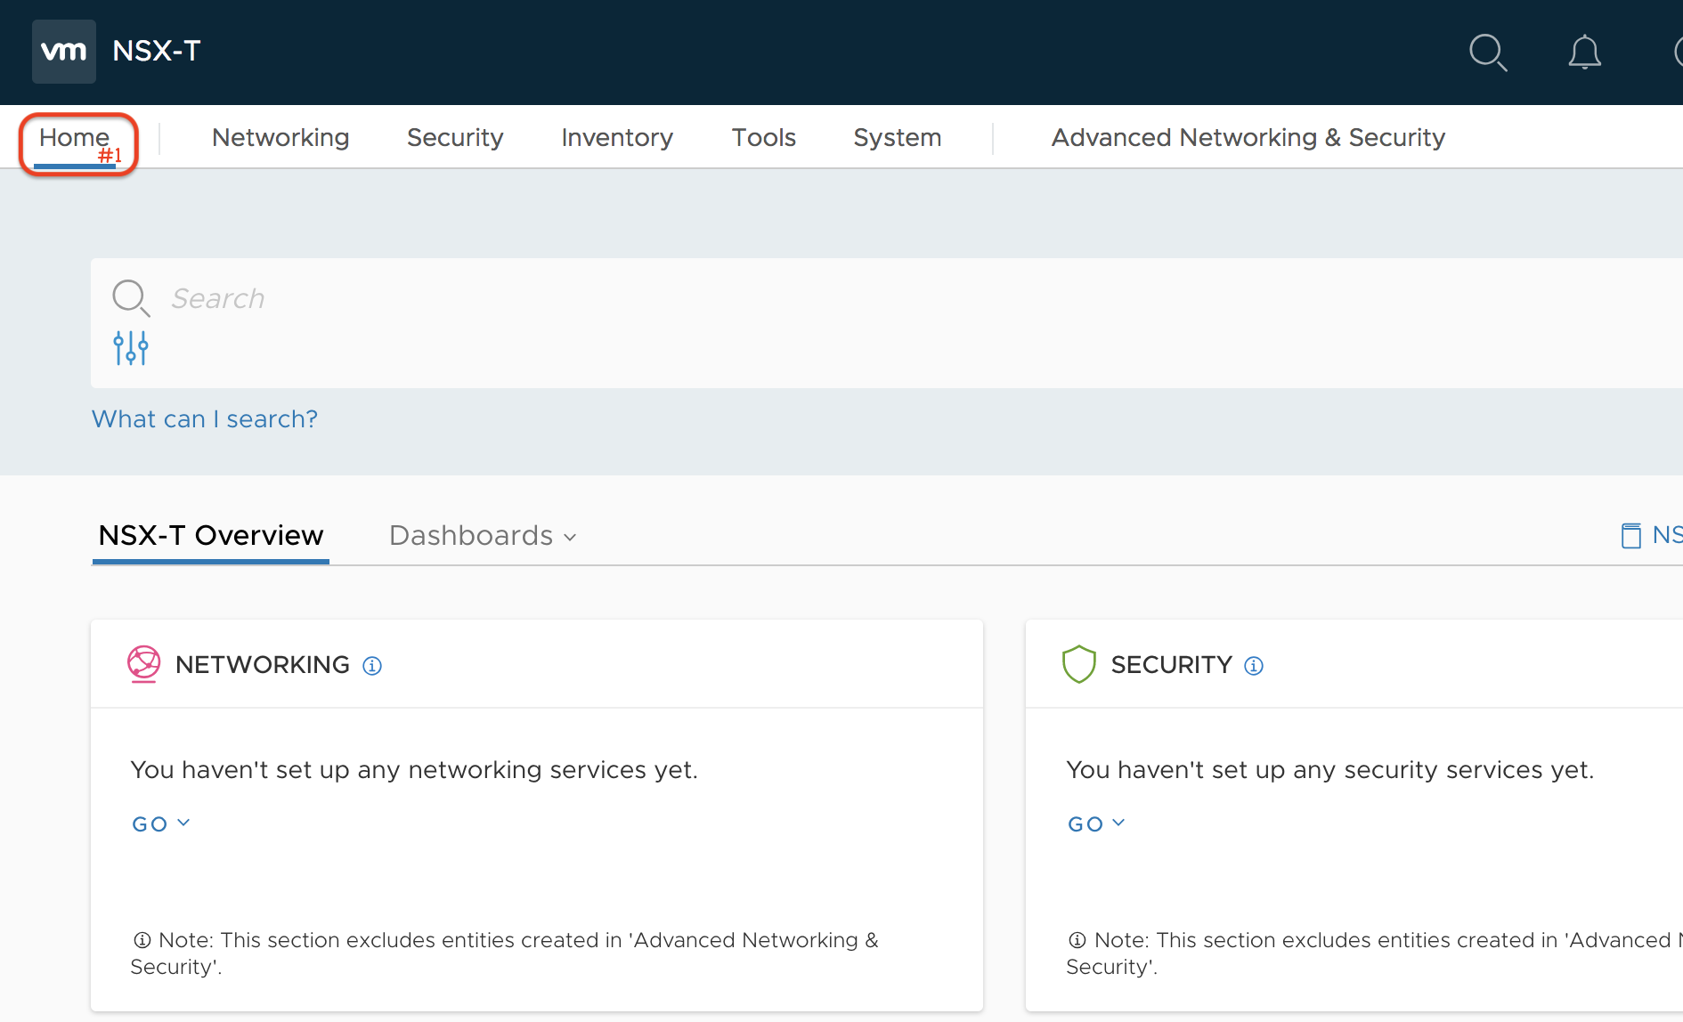
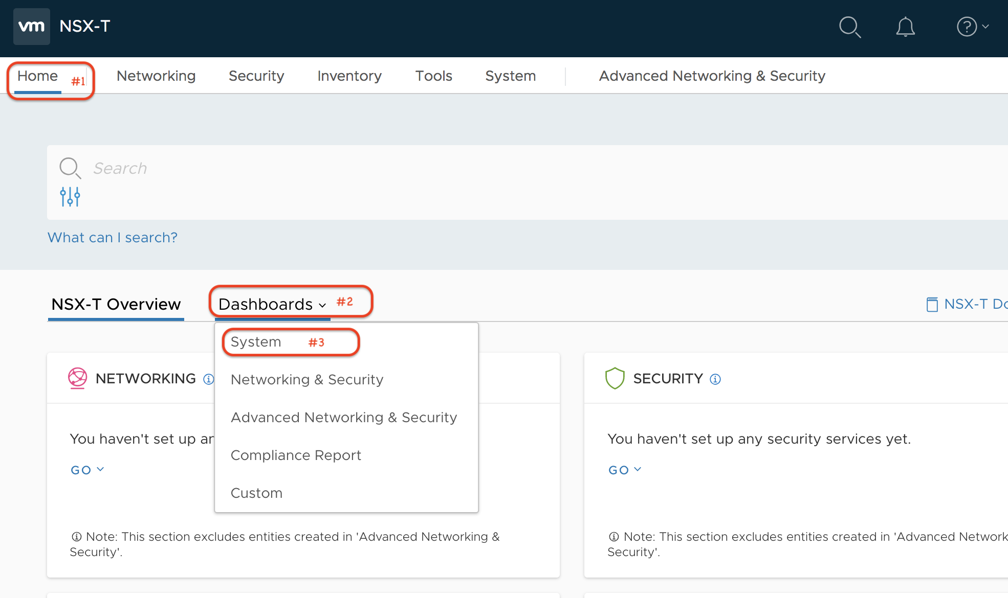
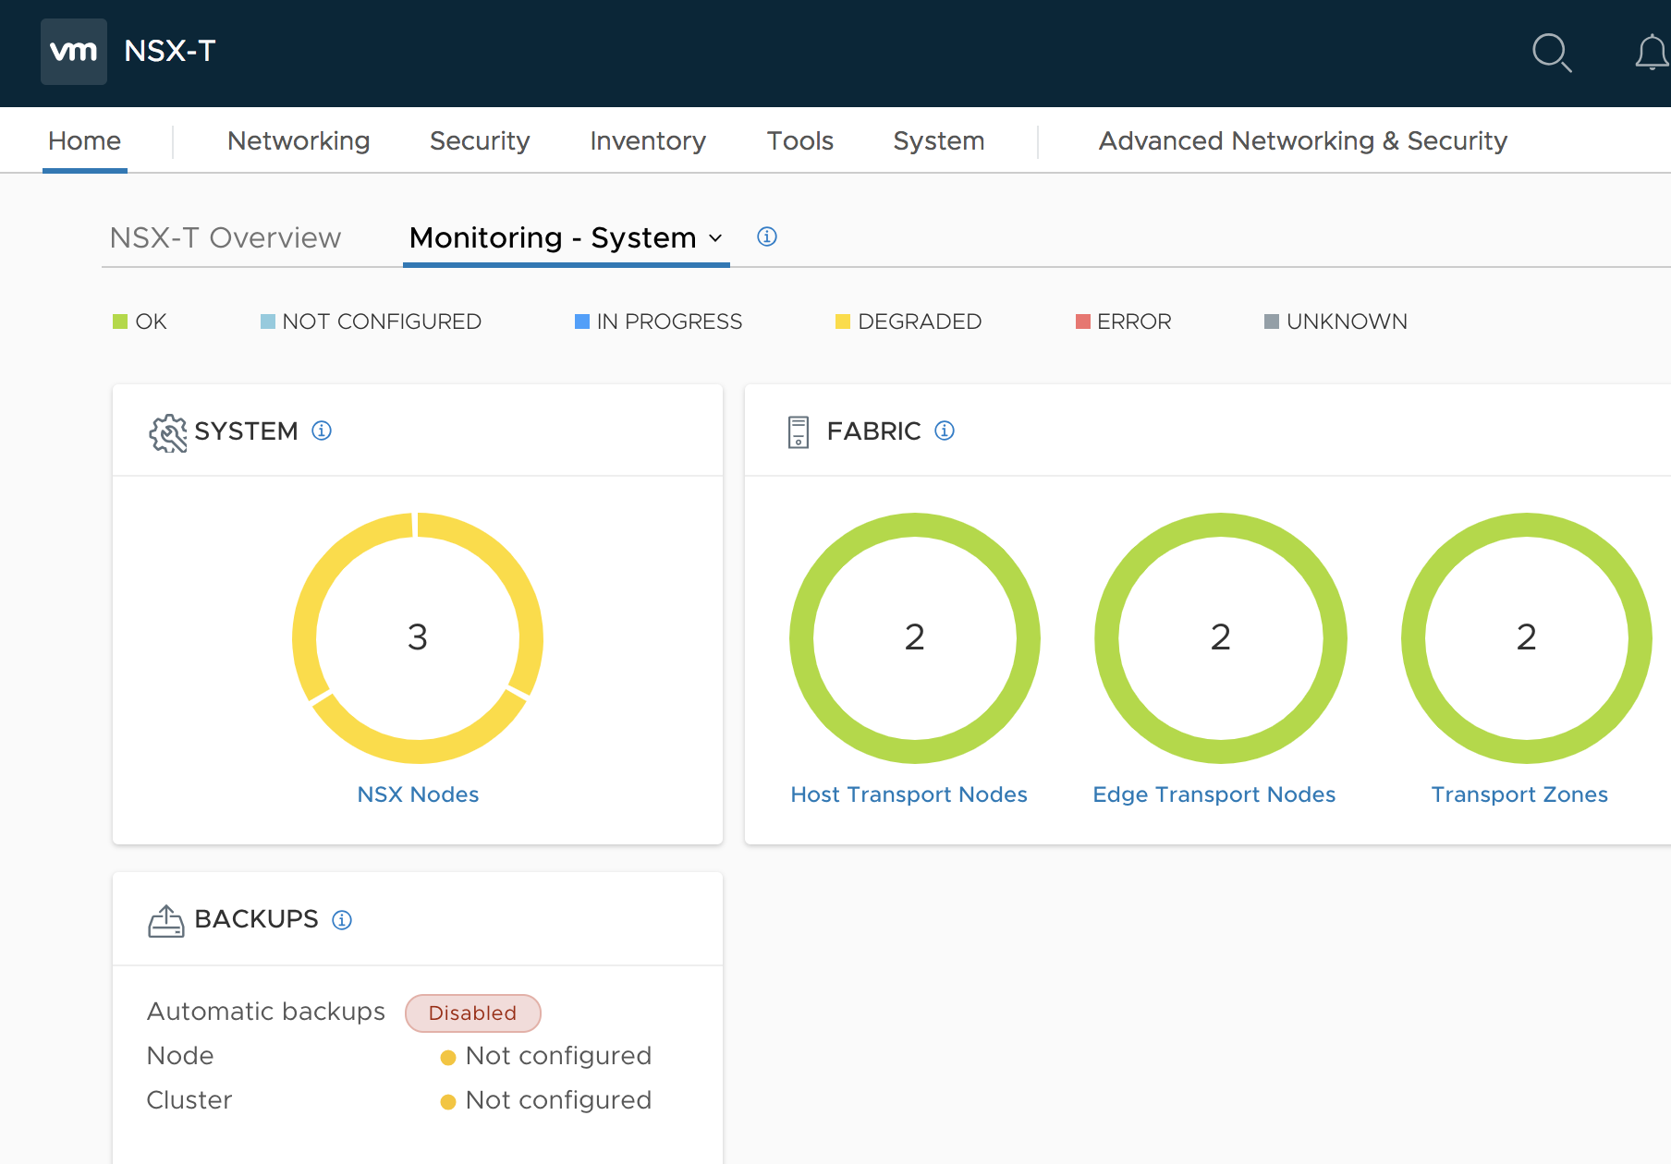
NSX Management Cluster
How to get to Dashboard

Slide 14
Management Clustering Deployment Options
Default mode –
Cons
API or GUI Client
All three node IP can be used for GUI and API access, however upon failure of that node, different IP has to be used
IP A
IP B
IP C
Pros
No Layer 2 adjacent requirement
NSX Management Cluster

Slide 15
Management Clustering
With External Load Balancer
API or GUI Client
Cons
More complex setup with LB configuration required
Costly
VIP
Pros
IP A
IP B
IP C
Single IP Availability
Scales - UI and API load distribution
Multi-subnet – no L2 across management racks
NSX Management Cluster

Slide 16
Management Clustering
With Cluster Virtual IP
API or GUI Client
Cons
No UI and API load distribution
VIP
Cluster Virtual IP 10.1.1.1
Pros
IP 10.1.1.10
IP 10.1.1.11
IP 10.1.1.12
Low cost
Low complexity
Single IP address can be used for API and UI access
NSX Management Cluster
Requirement
Single subnet only
Notes:
IP A – make real IP address -

Slide 17
Cluster Virtual IP
How VIP works
Cluster node which is the master for API services is assigned as the owner of the VIP
Allow clients to access the clustered NSX via one IP address
  Node IP changes does not impact the accessibility of the GUI or API
Reassigns a new owner of the VIP if certain services on the current owner come unavailable
Uses gratuitous ARP to update the MAC address table and ARP table
  All nodes in the cluster must be in the same subnet as the VIP

Slide 18
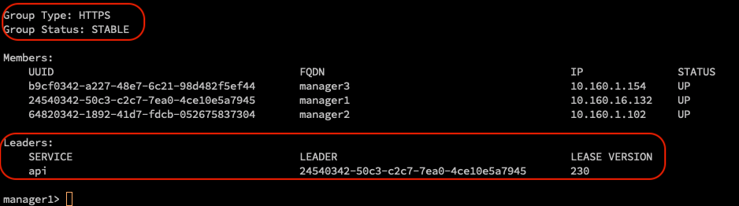
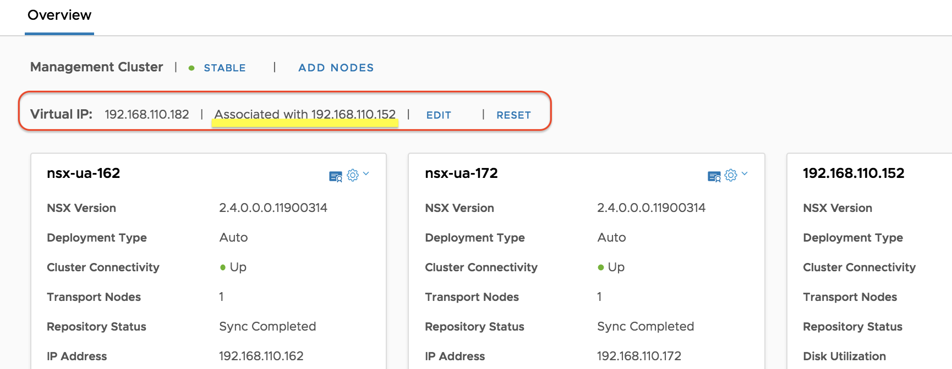
Cluster Virtual IP
Owner of VIP works
The Leader of API in HTTP Service Group owns the Cluster VIP
If the node fails, VIP will be automatically associated to another node
manager1> get cluster status verbose

Slide 19
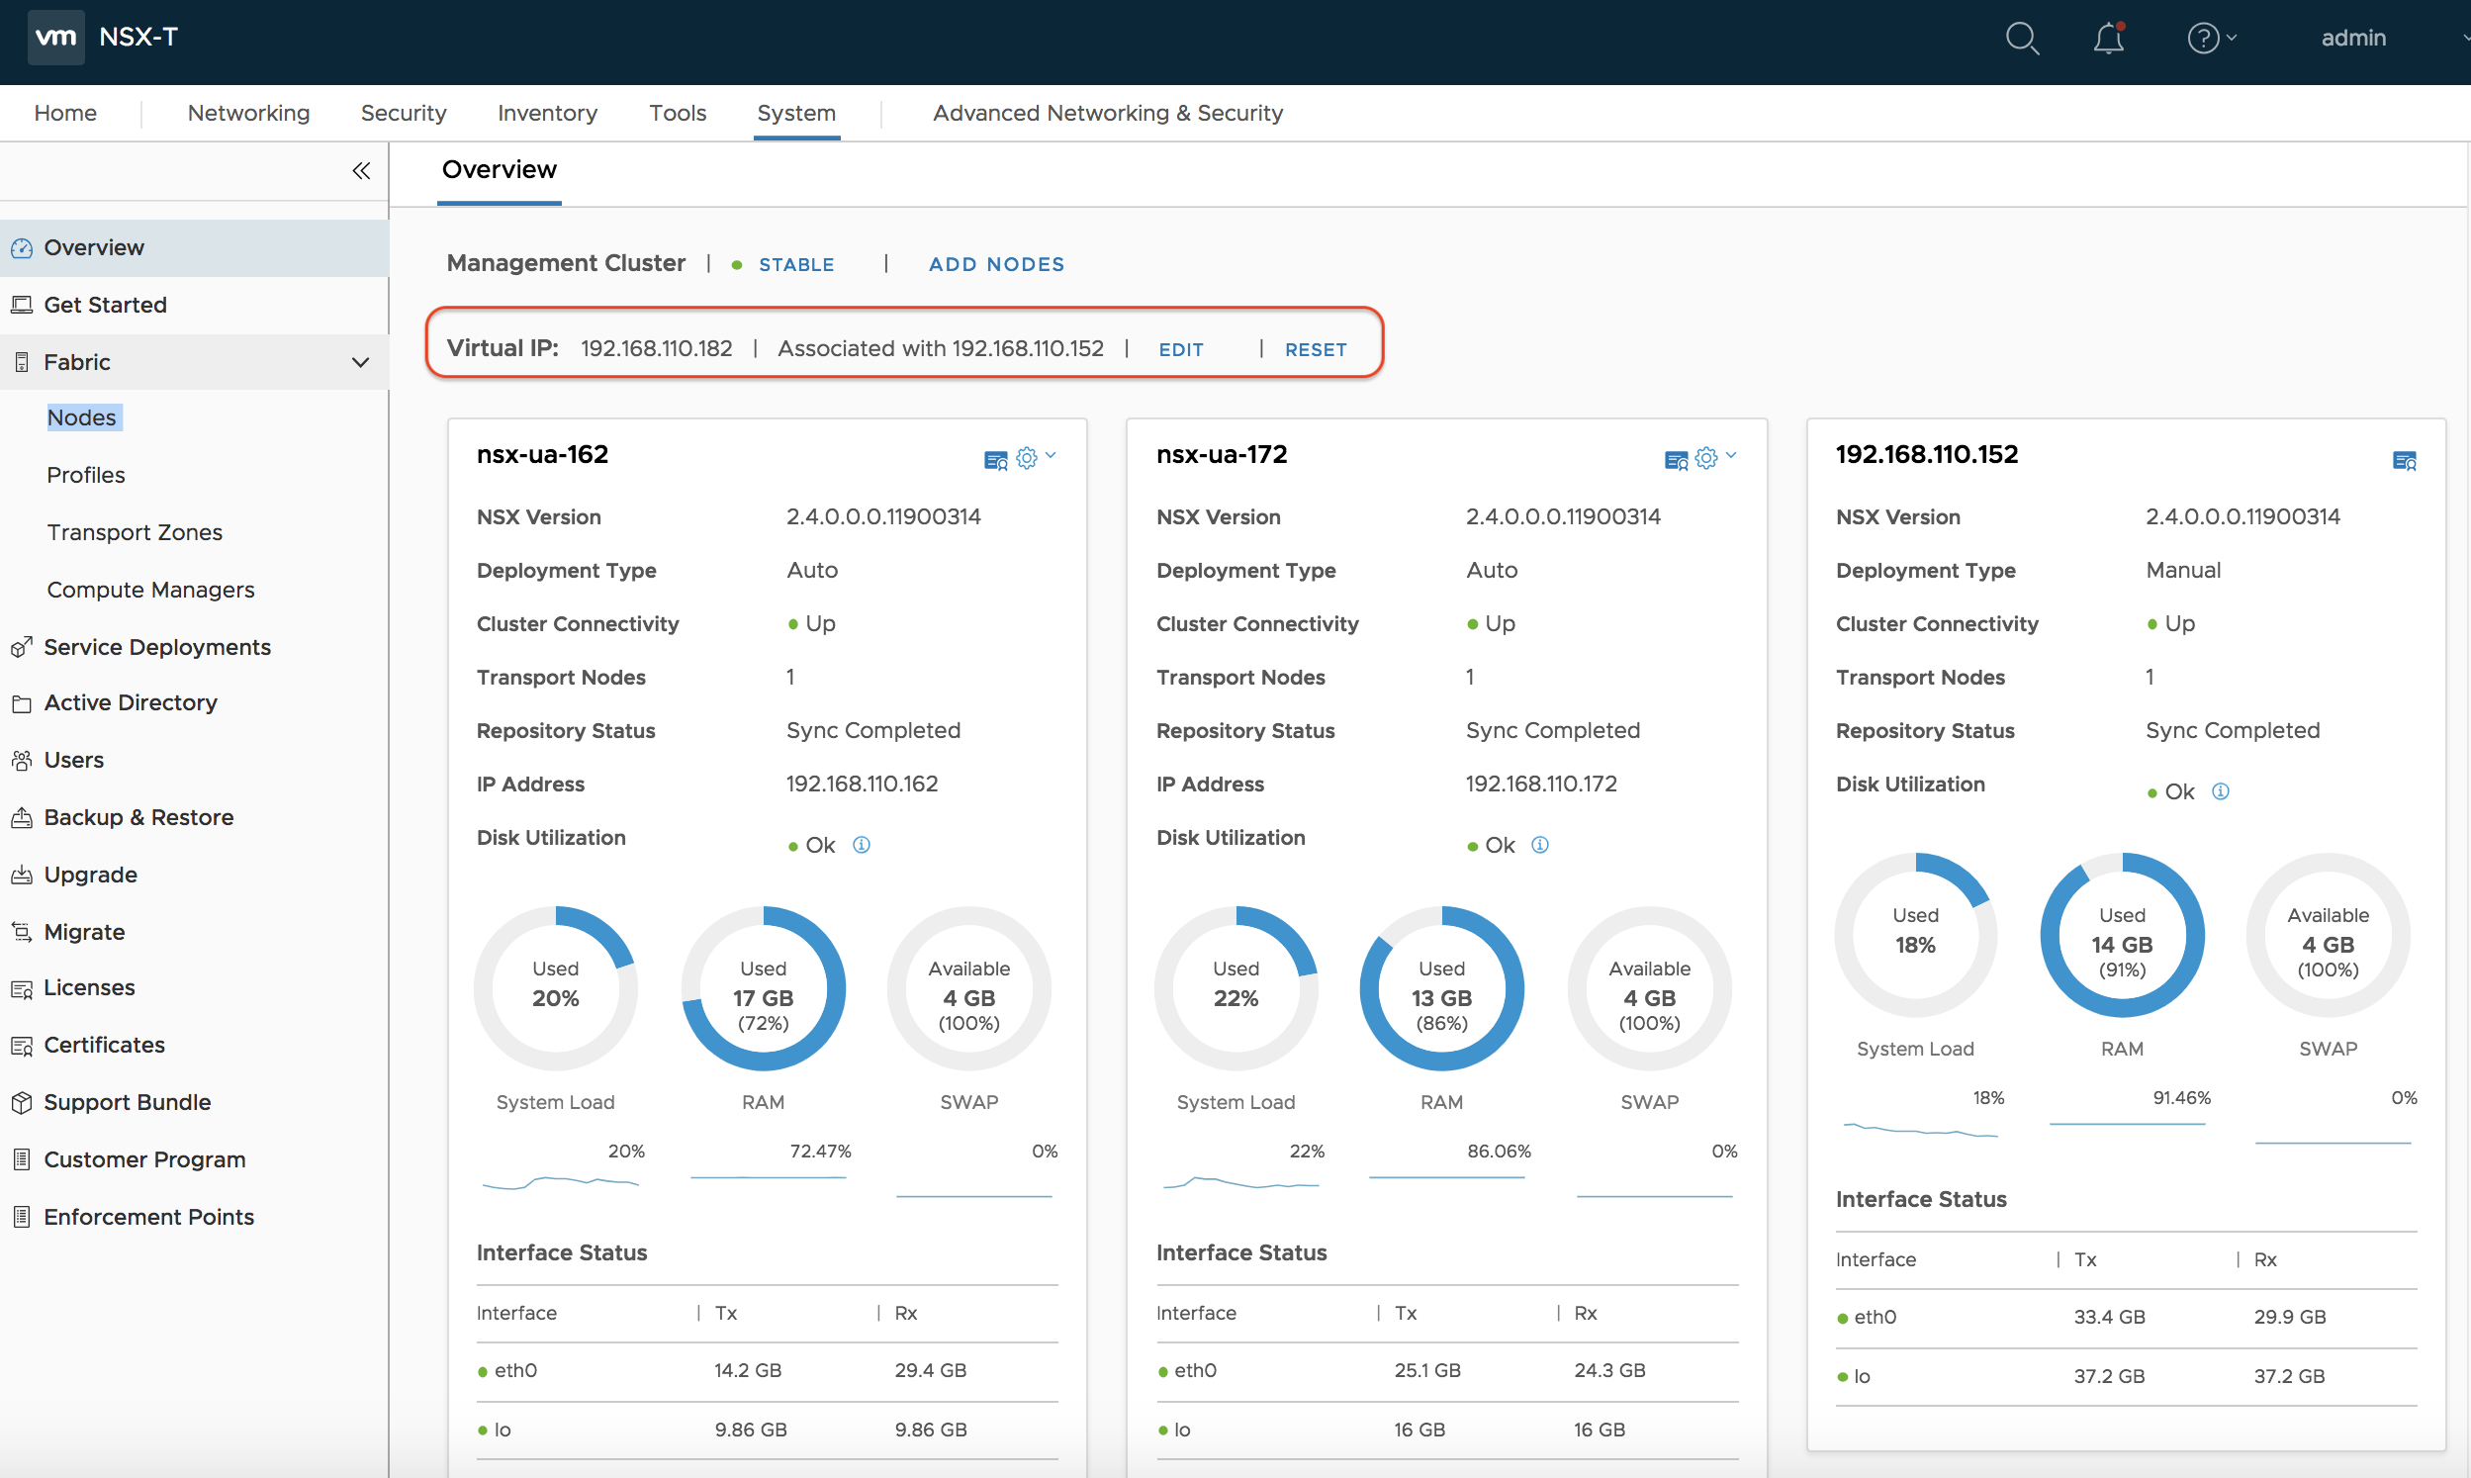
Configure Virtual IP
Virtual IP address can be configured via UI and API
VIP is associated with one node, show on GUI screen
POST https://{{nsx-mgr}}/api/v1/cluster/api-virtual-ip?action=set_virtual_ip&ip_address={{ip_address}}

Slide 20
Cluster Virtual IP
What does it do and does not do
Doesn’t do load balancing
  Only forward requests to the one node, does not distribute the load across the cluster
Doesn’t detect all service failures
  Only detect Reverse Proxy, Cluster Manager, Proton failures
Doesn’t failover existing sessions
  Clients need to re-authenticate
VIP is for Northbound access and configuration only
  Communication between manage node and other nodes via physical IP of each manager node

Slide 21
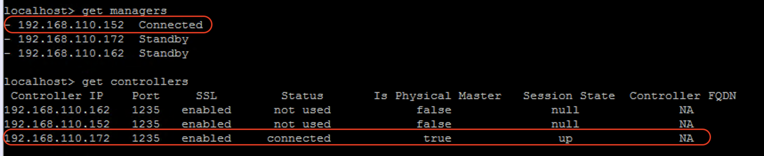
Deeper Look into Cluster Virtual IP
Only for Northbound access
Should be used for Northbound access and UI/API configuration only
Hypervisors communicate with NSX manager with the IP address on individual node

Slide 22
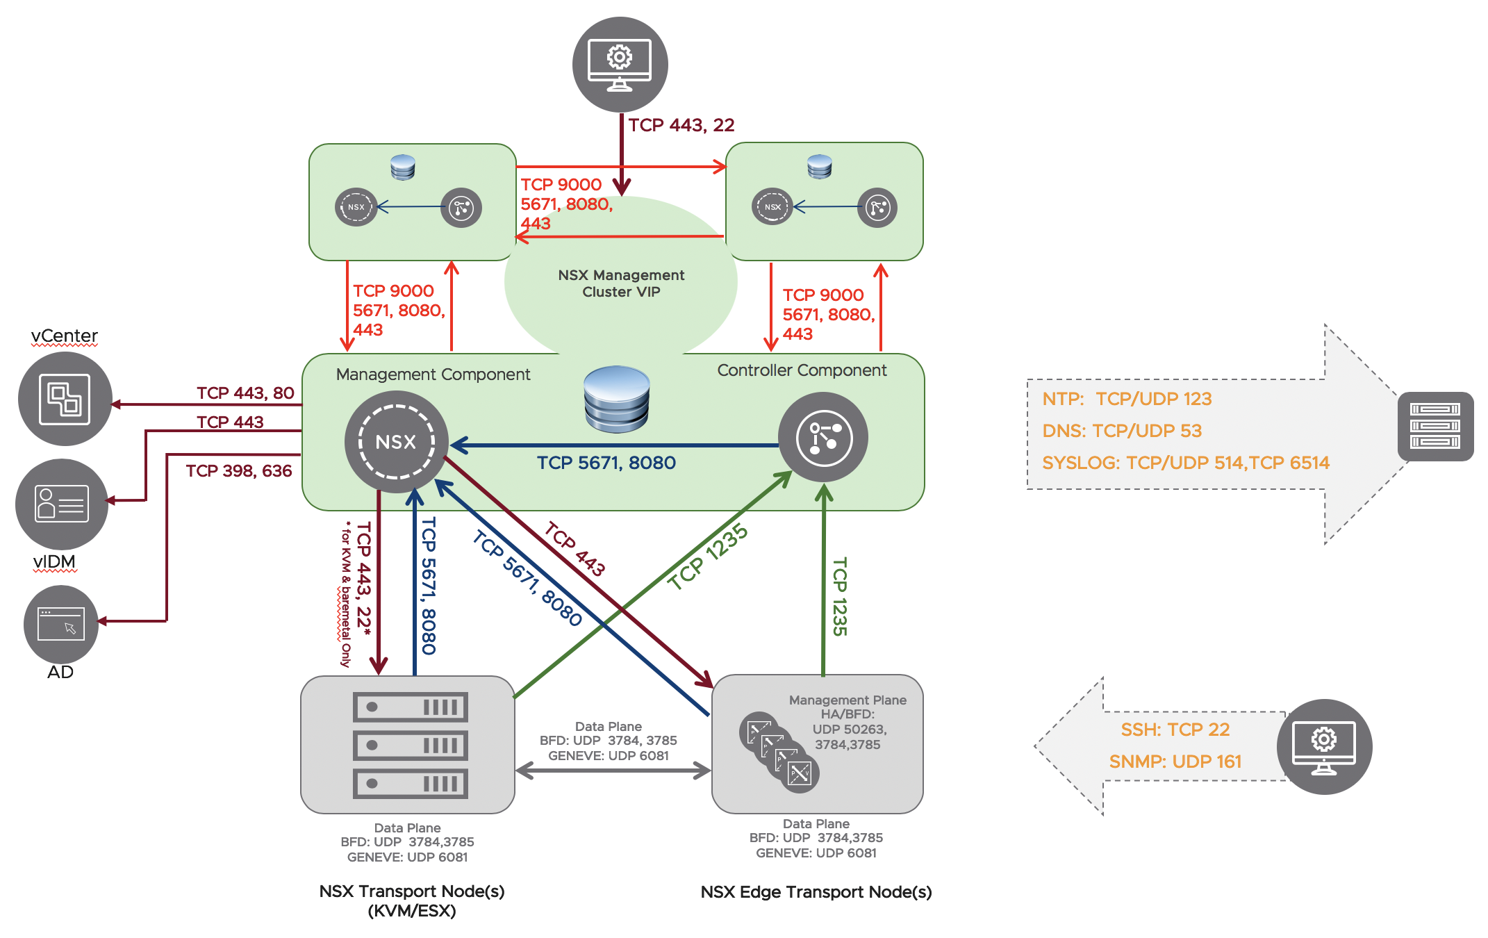
NSX-T Management Cluster
Communications between each process

Slide 23
Management, Control and Data Planes
NSX Manager Role
NSX Controller Role
Hypervisor Transport Nodes
Connected to all nodes in the system
Provides entry point to the system via UI or API
Persists user configuration
Handles user queries
Computes all ephemeral runtime states based on configuration from the management plane
Pushes stateless configuration to forwarding engines on transport nodes
Disseminates topology information reported by the data plane elements
The control plane is distributed between the Central Control Plane (CCP) and the Local Control Plane (LCP) agents on the hosts
Include the Local Control Plane (LCP) and the Management Plane Agent (MPA)
Local NSX Virtual Distributed Switch (N-VDS), component for data plane forwarding (Switching, Routing, Distributed Firewall) and Overlay (encapsulation / decapsulation)
This N-VDS is based on ESXi vSwitch for ESXi and Open vSwitch (OVS) for KVM

Slide 24

Declarative Policy vs. Imperative
Specify WHAT security your app needs, instead of HOW to secure in each environment
Microsegment 3-Tier Application
1) Create Group for each of the tier - WEB, APP & DB
2) Create DFW Section with Inter-app Rule
    ‘allow https from ANY to WEB’ ‘allow http from WEB to APP’ ‘allow mysql from APP to DB’
Declarative Interface
Imperative Interface
POLICY
NETWORKING CONFIGURATION
Imperative Interface
NETWORKING CONFIGURATION
Data driven - Static data structure with well defined meta info
Order independent - Object can be created/updated/ deleted in any order, result is always the same
Action Driven - interactive communication with the system
Order Dependent - Ordered execution of specific commands/actions
Notes:
The imperative approach uses procedural models that explicitly specify a process to be executed.
Imperative process models define explicitly all activities that have to be executed, their execution order, and the data flow between these activities.
It typically requires considerably more expertise as underlying systems are different details can be different.
The declarative approach uses structural models that describe the desired application structure and state, which are interpreted by a deployment engine to enforce this state.

Slide 25
NSX-T Declarative Policy Management Plane Architecture
NSX Policy framework
Declarative Policy Layer
GUI/REST/CMP
Policy UI/API for user Interaction
Declarative model – Data driven & order independent
Stores user intent in the distributed database
Interacts with NSX manager to translate user intent to desired config through ordered step by step config
Declarative Interface
Desired Config Store
(Distributed DB)
Policy Engine Layer
Intent Store
DISTRIBUTED PERSISTENT DB
Imperative Interface
NSX Manager Layer
Desired Config Store
Benefit
Simple, declarative statement of network & security needs
Define once, enforce everywhere
Infrastructure-agnostic policy definitions
NSX Control Plane Layer
Realized Config & Dynamic State
NSX Manager Appliance
Notes:
Declarative:
Data driven - Static data structure with well defined meta info
Order independent - Object can be created/updated/ deleted in any order, result is always the same
Imperative:
Action Driven - interactive communication with the system
Order Dependent - Ordered execution of specific commands/actions
The imperative approach uses procedural models that explicitly specify a process to be executed.
Imperative process models define explicitly all activities that have to be executed, their execution order, and the data flow between these activities.
It typically requires considerably more expertise as underlying systems are different details can be different.
The declarative approach uses structural models that describe the desired application structure and state, which are interpreted by a deployment engine to enforce this state.

Slide 26
Policy Model - Hierarchy
Identifies dependencies and invokes services in the right order, in single transaction
Infra
Key Properties
Modeled as Single Tree
Strongly Typed Nodes
Nodes can have relationship
Model maps to REST API
Site
Tier-0s
Tier-1s
Domain
LB Service, LB Pool …
GROUPS
Enforcement-point
Locale-services
segments
static-routes/ NAT/DNS..
Security-Policies
TransportZone
BGP ….
Simple, declarative statement of network & security needs
Object name/id/URI –user friendly with user configured name, unlike imperative URI based on system generated UUID
Port
Gateway-Policies
EdgeCluster
VPN …
Redirection-Policies
Note- Slide captures only main objects and relation with it’s child object. All relations are not shown for simplicity.
Notes:
Data model for NSX
NO POST, PATCH only
Object Name/id – remains as user configured name friendly to user, unlike traditional api/object based on system generated UUID
Note- All objects & Lateral relations between the objects is not shown for simplicity

